Slide 1
Lecture 14
Airline Program

Slide 2
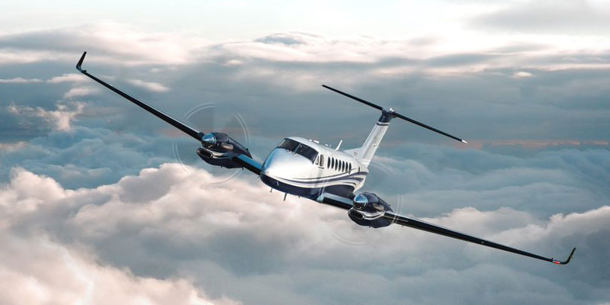
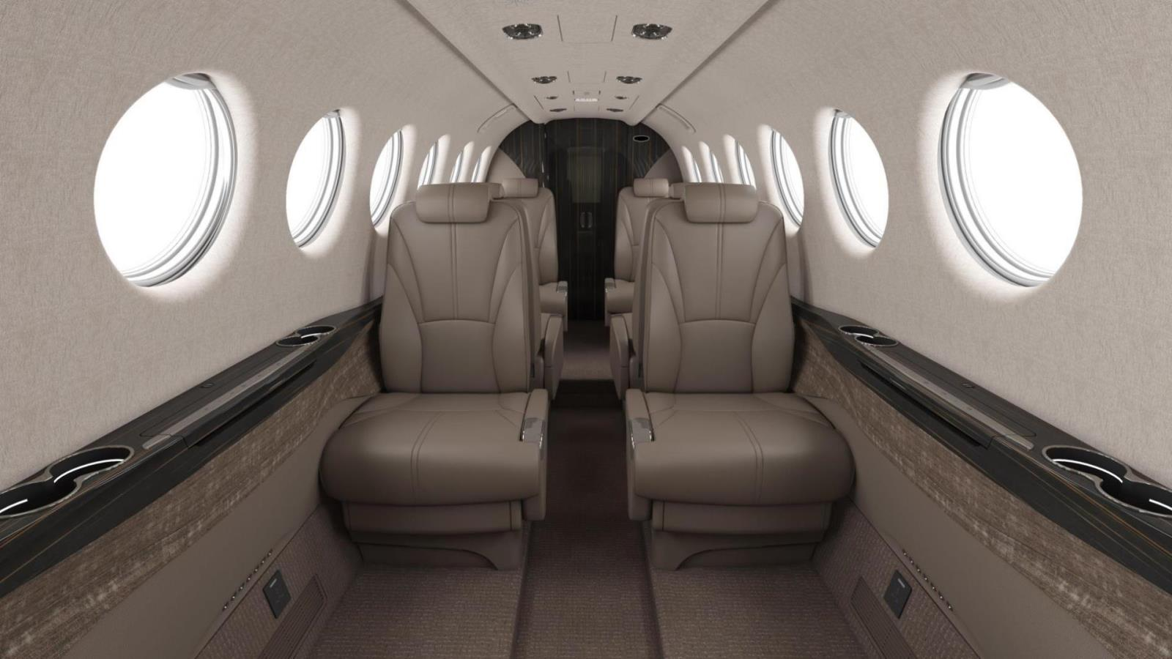
What do we know?

